Slide 1

Present By,
SIMPLE CALCULATOR
OBJECT ORIENTED PROGRAMMING
Under Supervision of,
Mr.Paras Kalaria
YASH PATEL (11CE091)

Slide 2
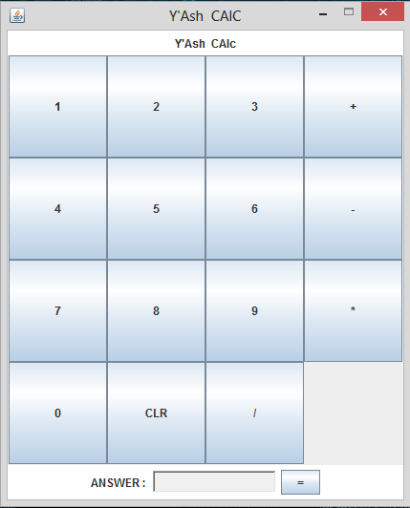
STEP-1 : CREATING A DESIGN

Slide 3
Design Applet Layout for calculator with using JPANNEL , JFRAME , JBUTTON .
1. Import packages :
1) import java.awt.*;
2) import java.awt.event.*;
3) import javax.swing.*;
2.Syntax For creating JBUTTON :
JButton button1 = new JButton(“ ");

Slide 4
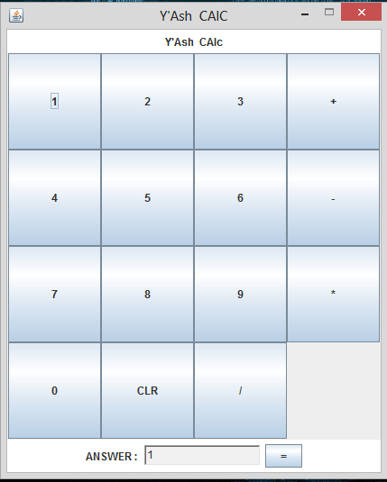
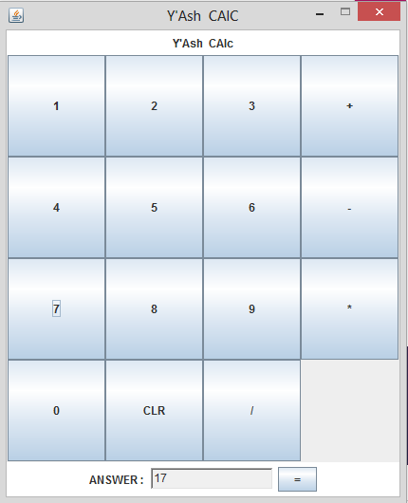
STEP-2: MAKE SURE ALL BUTTON IS WORKING
CONCATING NUMBER

Slide 5
Simple Way For Concatting The Number
* Treat the number as a String. Cast to Double when calculating.
* Pseudo code :
//Get text from textfield, put it into string s
//Concat s with other number (0,1,2,…,9)
//Set textfield with s

Slide 6
SIMPLE WAY TO INPUT ANY NUMBER IN TEXT AREA
if(e.getSource()==button1) {
txt.setText("1");
str_number+=txt.getText();
txt.setText(str_number); }

Slide 7
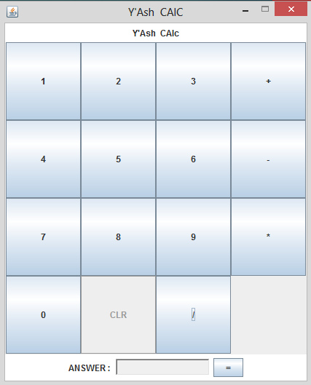
CHECK CLEAR BUTTON

Slide 8
CLEARING TEXT FIELD
else if(e.getSource()==clear) {
txt.setText("");
str_number = "";
operation = 0;
int_number1 = 0;
int_number2 = 0;
result = 0;

Slide 9
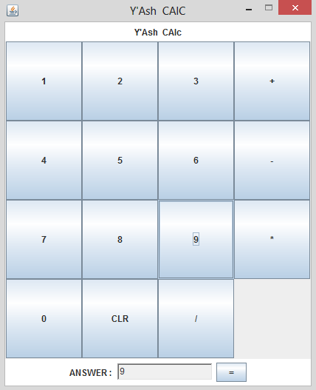
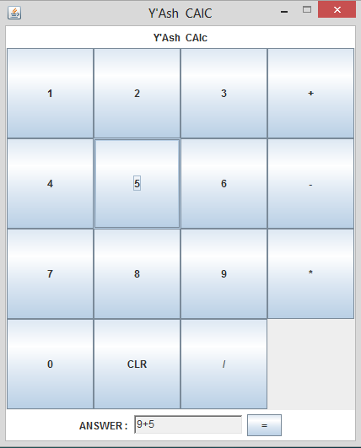
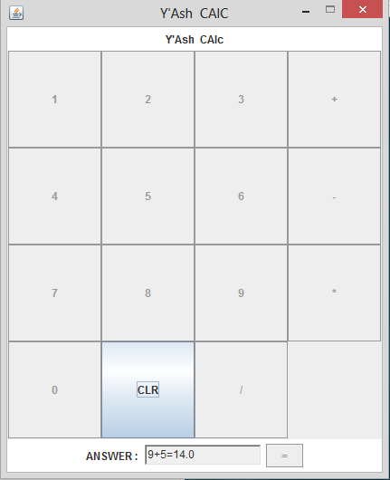
OPERATIONS
9
9+5
14

Slide 10
STRATERGY TO MAKE OPERATION WORKS
Stratergy :
- Create Two Variables :
* operator : to store the last operator
* operand : to store the last operand

Slide 11
HOW DOES IT WORK ?
This Button is Clicked
1: After finished Concating number,
user Clicks “ + “.

Slide 12
HOW DOES IT WORK ?
Operand : 98
Operator : “ + ”
Operand :10
Result : 108

Slide 13
LIMITATION
WE CAN DO ONLY ONE OPERATION AT A TIME.
WE HAVE TO USE CLEAR BUTTON AFTER EVERY OPERATION.
WE HAVE TO USE CLEAR BUTTON AFTER GETTING RESULT.
WE CAN DO ONLY FEW SIMPLE MATHEMATICAL CALCULATIONS WITH USING THIS CALCULATOR.

Slide 14
THE END
THANK YOU

